Slide 1

Modelling of anime scores on MyAnimeList.com
Project 2
Metis Data Science Bootcamp
By Ouyang Yingzhao
Photo by Tim Mossholder on Unsplash

Slide 2

Objectives
Based on features of an anime listing on MyAnimeList.com (MAL), predict its overall user score
The resultant model would indicate what features of an anime (e.g. episode length, genre) might influence its perceived quality (i.e. overall user score)

Slide 3
Methodology
Data retrieval
Data preparation
Feature selection
Model selection

Slide 4


Data retrieval
Obtained via
web scraping
Total dataset
16,706
Retrieved in 335 batches of 50 between 23 and 24 April 2020

Slide 5
Data retrieval
Total dataset
16,706
DROPPED

Slide 6

Data retrieval
With scores
11,541
DROPPED
Imported into

Slide 7
List of initial features
No | Feature | Description
1 | Type | TV, Movie, OVA, ONA, Music, Special, Other
2 | Status | Finished Airing, Currently Airing, Not yet aired
3 | Length | Number of minute per episode
4 | Episodes | Number of episodes
5 | Rating | 5 ratings from “G – All” to “Rx – Hentai”, and “Unknown”
6 | Members | How many MAL members have it on their list
7 | Favorites | How many MAL members have it on their favourite list
9 | Started | Date that anime started (if no day given, assume first of the month; if no month, assume first day of the year)
10 | Ended | Date that anime ended
11 | Voters | How many MAL members gave the anime a score
12 | Genres | Which genre(s) the anime is in; 42 total
13 … 20 | Adaptation … Prequel | What associated properties (adaptations, sequels, side-stories, prequels etc) the anime has; 8 features total

Slide 8
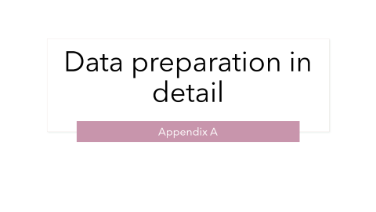
Data preparation
Dropped NaN data
Shows that have not finished airing
Shows with no start date
Cleaned NaN data
E.g. Movies with NaN episodes → 1 episode
Treated categorical data and added counts
Transformed features with log10, nested log10, sqrt
Clipped episodes and duration, multiplied to get clipped length

Slide 9


Feature selection
Using t-scores of statsmodel.OLS
P(t-score) threshold = 0.05
Using LASSO from scikit-learn
lambda = 0.01
parameter threshold = 0.01

Slide 10
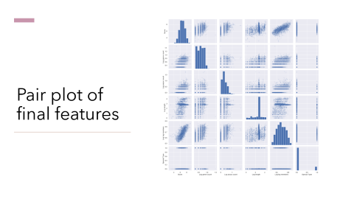
Feature selection: final list
No | Feature | Description
1 | Log genre count | Log10 of the number of genres associated with the anime
2 | Log associated count | Log10 of the total number of properties associated with the anime
3 | Log length | Log10 of the clipped length of the anime (clipped duration X clipped episodes)
4 | Log log members | Total number of members with the anime on their list, log10 twice
5 | Special Type | Whether the anime is a special episode (e.g. Christmas special)

Slide 11


Model selection
Models | Metrices
Linear Regression LASSO Ridge 5-fold cross validation performed on all models | R² Mean squared error (MSE) Mean absolute error (MAE) Max error

Slide 12
Model selection
Linear Regression | LASSO | Ridge
R²: 0.56 MSE: 0.34 MAE: 0.44 Max Error: 4.73 | R²: 0.56 MSE: 0.34 MAE: 0.44 Max Error: 4.72 Lambda = 0.001 | R²: 0.56 MSE: 0.34 MAE: 0.44 Max Error: 4.73
Marginally better than the other two

Slide 13
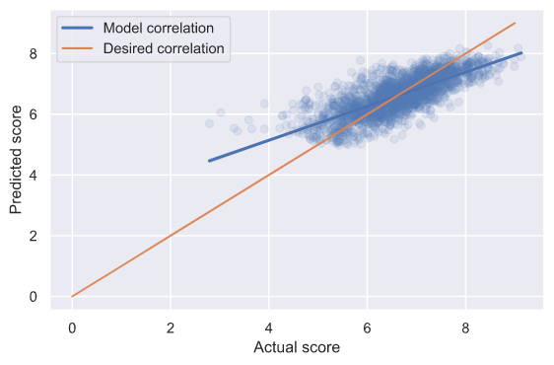
Test results
R²: 0.57
MSE: 0.32
MAE: 0.43
Max Error: 3.04

Slide 14
Observations
Model appears robust enough to indicate whether an anime may receive a high or middling rating
Model has a negative skew: biased towards higher ratings for scores < 5, and towards lower ratings for scores > 8
Not many scores below 5 to begin with, likely due to the nature of online user ratings

Slide 15
Next Steps
Linear regression models not sufficient to accurately model relationship between score and anime features
Large negative skew (~ -1) and large kurtosis (~ 6) observed
Though MSE and MAE are relatively low compared to the anime score, the max error is a significant portion of it
Graph shows significant scatter
More sophisticated models need to be tested

Slide 16

Thank you for your attention
Photo by Bruce Tang on Unsplash

Slide 17
Data preparation in detail
Appendix A

Slide 18
Data preparation in detail
Limited data further:
Only shows that have finished airing (150 shows currently airing or not yet aired dropped)
Dropped shows with no start date (7 shows)
Cleaned NaN data:
Movies with NaN episodes → 1 episode

Slide 19
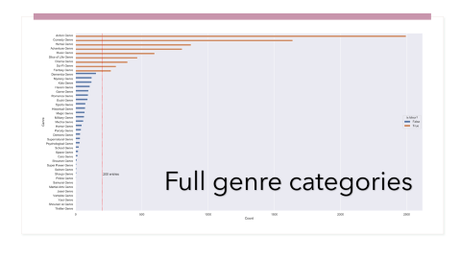
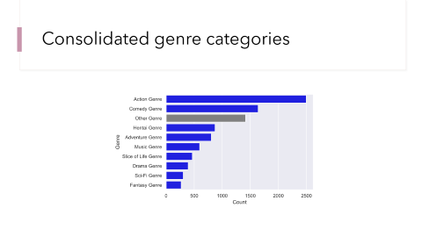
Data preparation in detail
Categorical features
Genres → dummy variables (10 total including ‘Other’)
Type → dummy variables (7 total including ‘Other’)
Rating → values based on restrictiveness of rating (0 for G, 5 for Hentai; None ratings assigned to PG, the most common rating

Slide 20
Data preparation in detail
Included counts for genres; converted associated columns to counts and included overall associated count

Slide 21
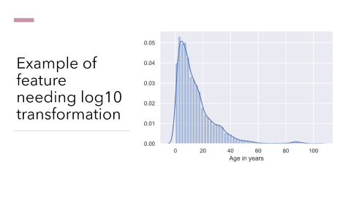
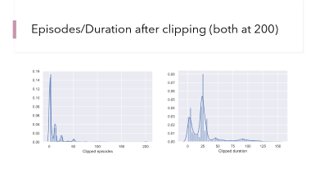
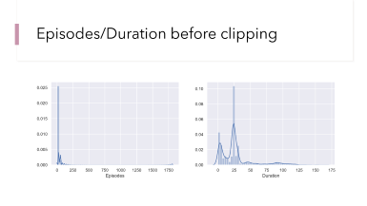
Data preparation in detail
Clipped episodes and duration to 200 each
Clipped length = clipped episodes X clipped duration
Started/Ended: assume 1st day of month if no day given; assume 1st January if no month given
Obtain year started, age of anime
Apply log10, nested log10, sqrt

Slide 22

Detailed charts and figures
Appendix B
Plotted with

Slide 23
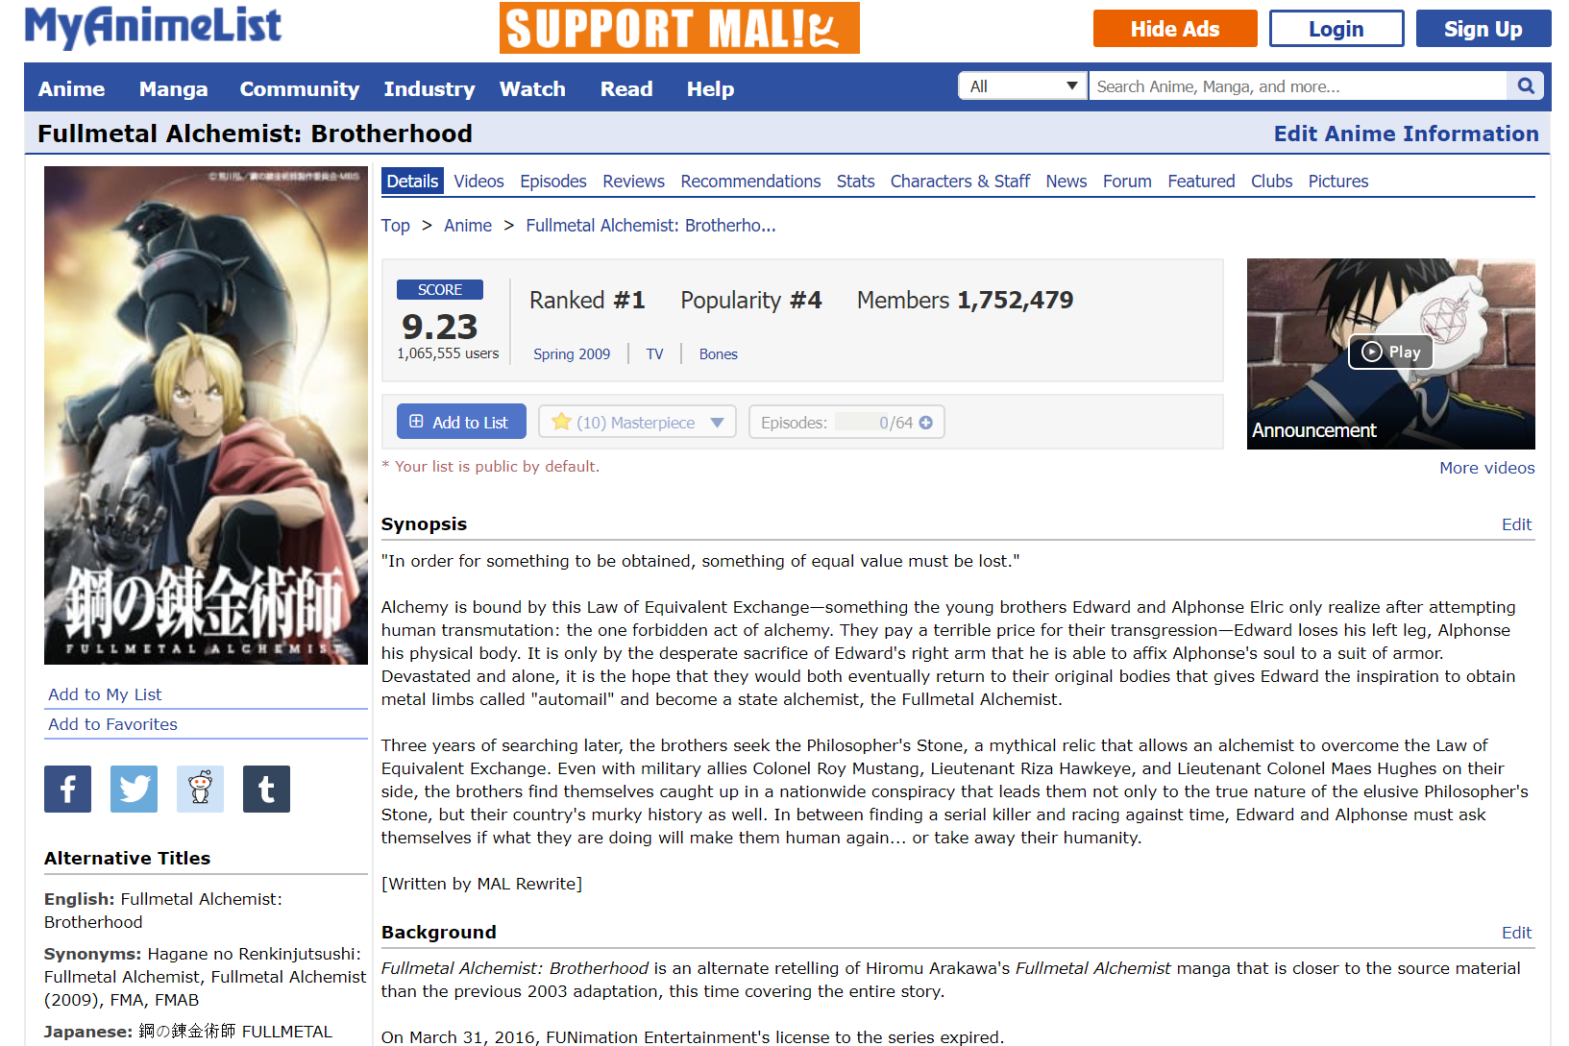
Example of MAL listing

Slide 24
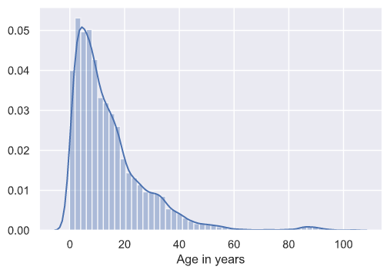
Example of feature needing log10 transformation

Slide 25
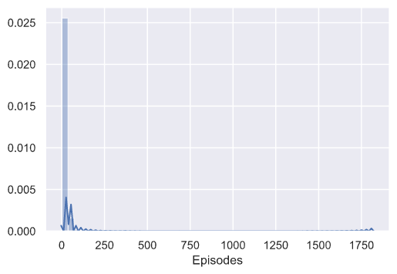
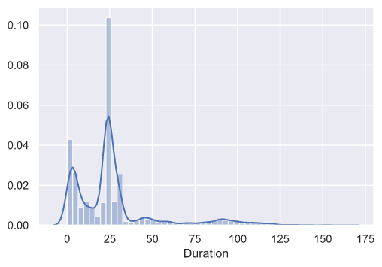
Episodes/Duration before clipping

Slide 26
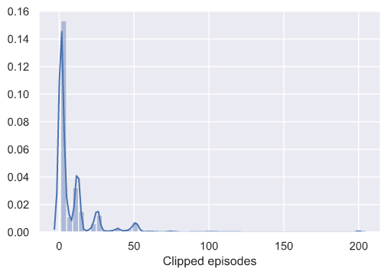
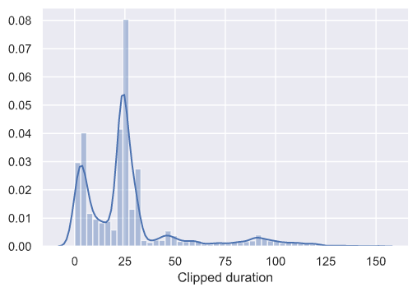
Episodes/Duration after clipping (both at 200)

Slide 27
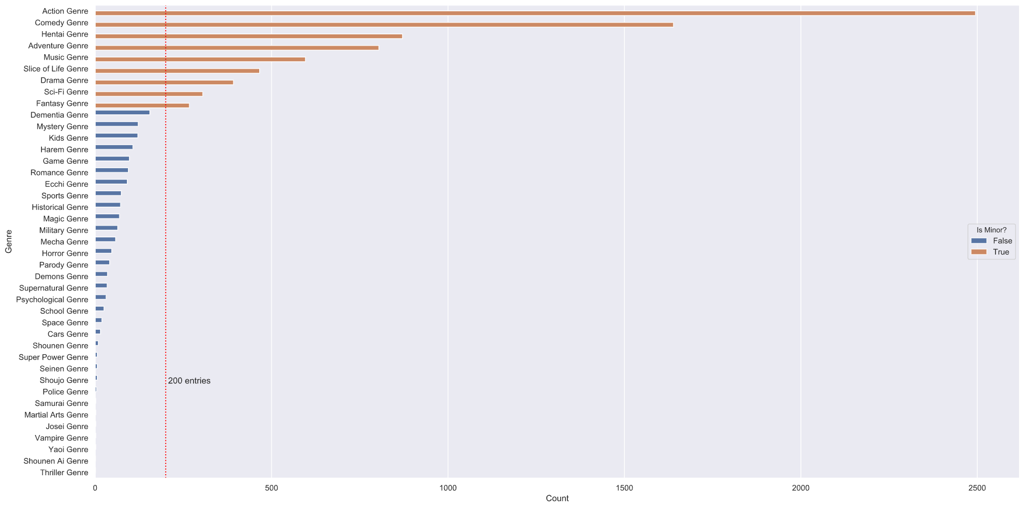
Full genre categories

Slide 28
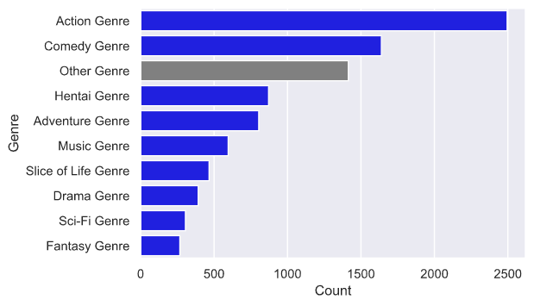
Consolidated genre categories

Slide 29
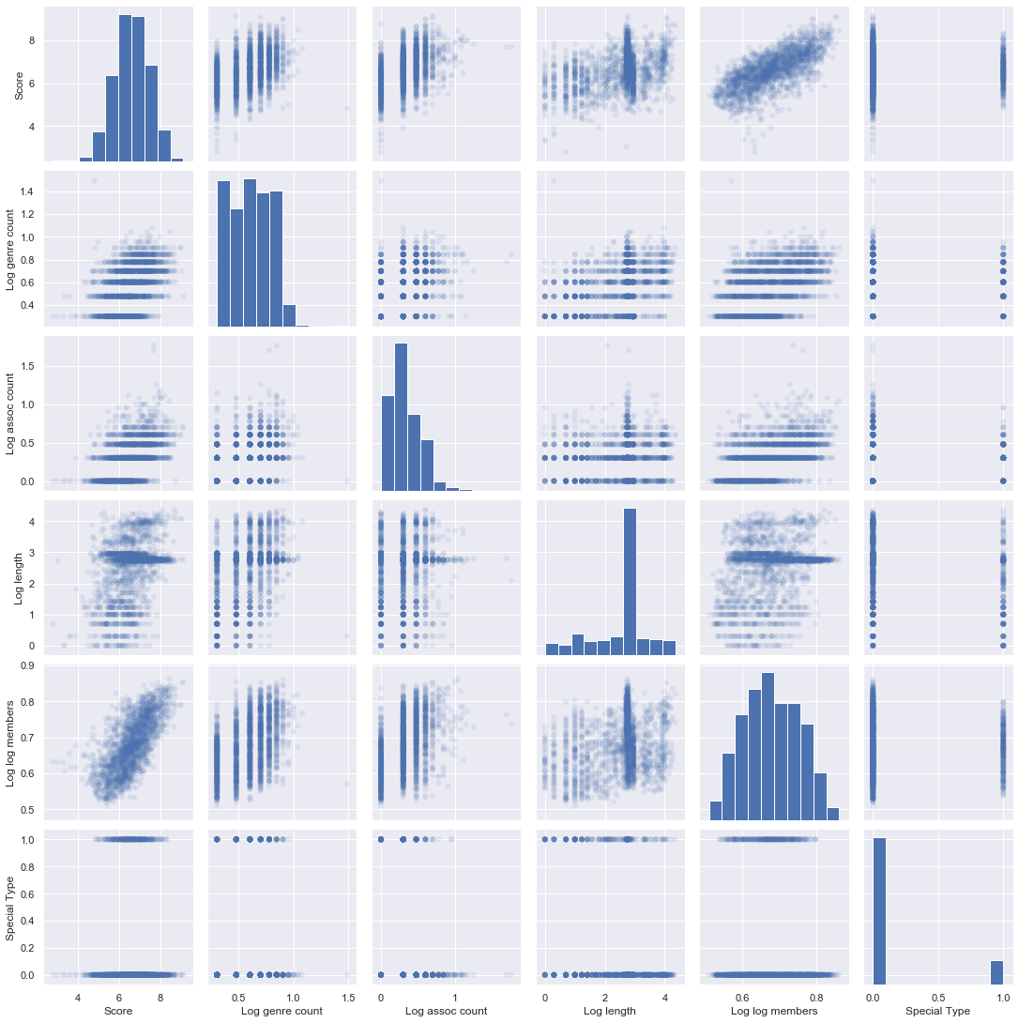
Pair plot of final features

